Slide 1
Reliable Frontends
A Journey into JavaScript Frontend Testing

Slide 2
The Focus
For JavaScript applications
Writing tests for Frontend logic
Unit/Integration tests

Slide 3

JavaScript ??
> 5+5
< 10
> 5 +'5'
< ‘55’
>'5'+ 5
< ‘55’
>5 + + '5'
< 10
> '5' + + 5
< ‘55’
> '5' - - 5
< 10
> NaN === NaN
< false

Slide 4
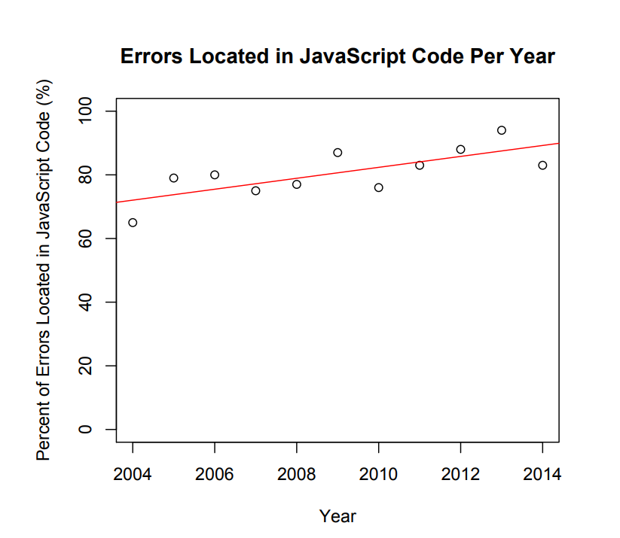
Client-side Bugs Analysis
83% of JavaScript faults are caused by errors manually introduced by JavaScript code programmers
Around 68% of JavaScript faults are DOM-related;
DOM-related faults take longer to fix than non-DOM-related faults.
[1] A Study of Causes and Consequences of Client-Side JavaScript Bugs

Slide 5
What? & How ?
What should be tested in frontends ?
How they should be tested ?

Slide 6
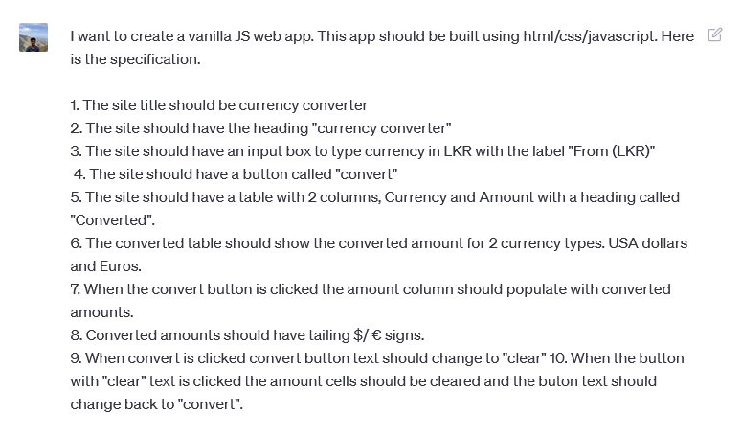
I asked Chat GPT
Build a currency converter.

Slide 7
What?
Should have title “Currency Converter”
Should have heading “Currency Converter”
Should have a label “From (LKR)
Should convert when convert button clicked.
Button text should be clear when convert is clicked
Converted amounts should have tailing $/€‎ signs

Slide 8
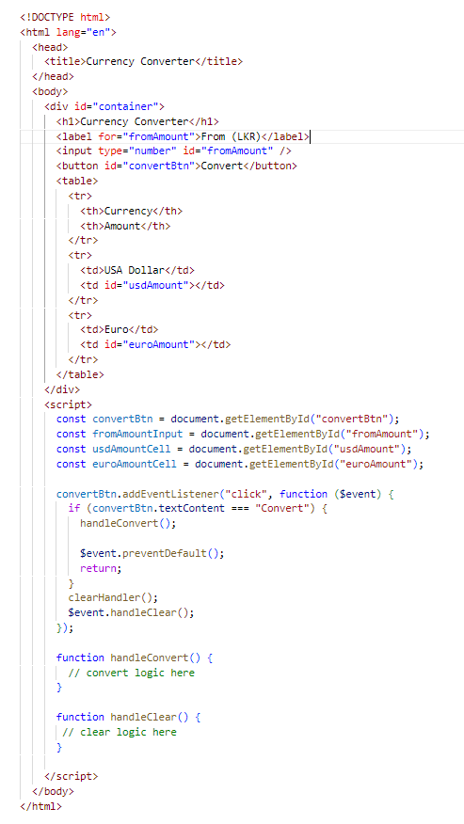
How?
Button text should be clear when convert is clicked.
Simulate a click when button text is “convert” &
check the button text is changed to “clear”.
convertBtn.click();
const btnText = convertBtn.textContent;
if(btnText === 'clear'){
// pass the test
}
else{
// fail the test
}
Chat GPT’s implementation

Slide 9
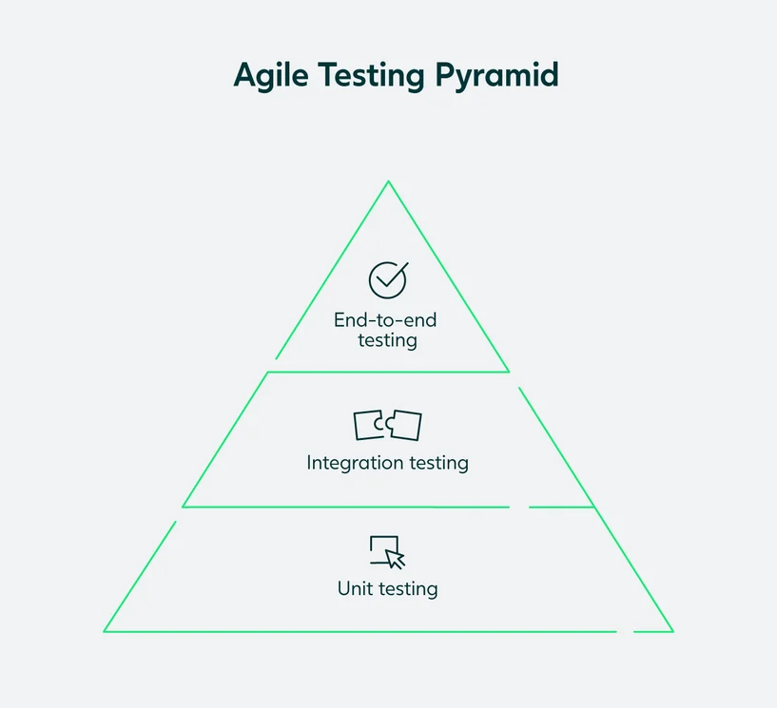
Buzz words
Fixtures and testcases
BDD
Stub Types
Test framework
Assertion Library
Test Runner
Test Environment

Slide 10
Demo 1
How to write a testable frontend code.

Slide 11
Demo 2
Test frameworks

Slide 12
Demo 3
Unit and Integration testing

Slide 13
Ref
[1] Ocariza, Frolin & Bajaj, Kartik & Pattabiraman, Karthik & Mesbah, Ali. (2016). A Study of Causes and Consequences of Client-Side JavaScript Bugs. IEEE Transactions on Software Engineering. 43. 1-1. 10.1109/TSE.2016.2586066.

